Slide 1
Employee Data Analysis using Excel
STUDENT NAME: R .SRINIDHI
REGISTER NO: 122200229 & asunm110122200229
DEPARTMENT: COMMERCE
COLLEGE: D.R.B.C.C.C HINDU COLLEGE

Slide 2
PROJECT TITLE
Employee Performance Analysis using Excel

Slide 3


AGENDA
Problem Statement
Project Overview
End Users
Our Solution and Proposition
Dataset Description
Modelling Approach
Results and Discussion
Conclusion
3/21/2024 Annual Review

Slide 4

PROBLEM STATEMENT
Analyzig Employee experience
Involves the collection, analysis, and interpretation of data related to employees
interaction, satisfaction, engagement, and overall experience within an organization.

Slide 5

PROJECT OVERVIEW
Creating a project overview for employee experience in Excel involves structuring your data and analysis in a way that helps track and manage the project's progress effectively. use Excel features like conditional formatting, data validation, and pivot tables to manage and analyze data effectively. This structure will help ensure that the project is well-organized and that progress is easily trackable.
.

Slide 6

WHO ARE THE END USERS?
- HR PROFESSIONAL
- Manager/ Supervisor
- Executives/ Leadership

Slide 7

OUR SOLUTION AND ITS VALUE PROPOSITION
CONDITIONAL FORMATTING
FILTER- REMOVE
PIE CHART

Slide 8
Dataset Description
EMPLOYEE DETAILS -KAGGLE.COM
42 FEATURES
NAME - TEXT
GENDER- MALE OR FEMALE
EDUCATION - BACHELORS, MASTERS
WORK LOCATION - TEXT
DEPARTMENT
EXPERIENCE

Slide 9

summary
* TO FIND THE EXPERIENCE OF THE EMPLOYEE USING THE EXCEL
* THE RESULT SHOWN IN THE PIE CHART
3/21/2024 Annual Review
9

Slide 10
MODELLING
DATA COLLECTION
* COLLECTED FROM KAGGLE.
FEATURE COLLECTION
* MERGE & CENTRE
EXPERIENCE LEVEL
* NUMBER OF EMPLOYEE IN EACH EXPERIENCE LEVEL
10

Slide 11
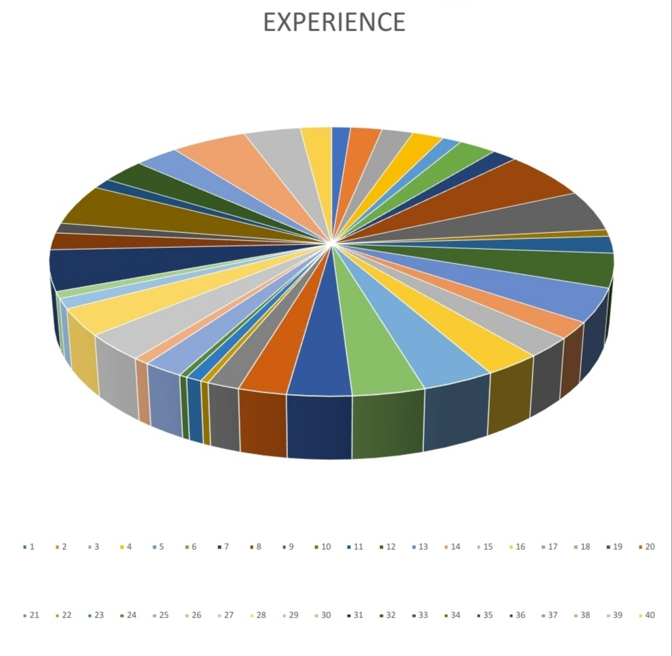
RESULT
11

Slide 12
conclusion
IN THIS EXPERIENCE ANALYSIS THE SOME OF EMPLOYEES ARE GET HIGHER EXPERIENCE IN THE DEPARTMENT OF PURCHASE AND QUALITY, FINANCE

